Slide 1
Metaprogramming in .NET
Jason Bock
Practice Lead

Slide 2
Personal Info
http://www.magenic.com
http://www.jasonbock.net
https://www.twitter.com/jasonbock
https://www.github.com/jasonbock
jasonb@magenic.com

Slide 3
Downloads
https://github.com/JasonBock/CodeSnippets
https://github.com/JasonBock/Rocks
https://github.com/JasonBock/Presentations/blob/master/Metaprogramming%20in%20.NET.pptx

Slide 4
Overview
Definitions
Snippets
Reflection
Expressions
Compilation
Remember…
https://github.com/JasonBock/CodeSnippets
https://github.com/JasonBock/Rocks
https://github.com/JasonBock/Presentations/blob/master/Metaprogramming%20in%20.NET.pptx

Slide 5

Definitions
http://kauilapele.files.wordpress.com/2011/11/magic.gif
Notes:
It’s all magic….but not really ☺

Slide 6
Definitions
Metaprogramming: The writing of computer programs that write or manipulate other programs (or themselves) as their data, or that do part of the work at compile time that would otherwise be done at runtime.
http://en.wikipedia.org/wiki/Metaprogramming
Notes:
This is a pretty typical definition of metaprogramming.

Slide 7
Definitions
“The meta prefix can mean changed or higher. It can also mean after or beside, depending on the context. All of those terms describe … various forms of metaprogramming.”
http://manning.com/hazzard/
Notes:
This is the definition I used in my book, but what does it mean? Let’s look at a couple of simple examples.

Slide 8

Definitions
dynamic x = Program.Create();
x.MyProperty = 42;
x.Calculate();
http://1.bp.blogspot.com/-MoYos-iLGR0/Tclyxk6kH6I/AAAAAAAAF08/8aX2fOxBKlo/s1600/magical-merlin-sundara-fawn.jpg
Notes:
With C# 4, you can use the dynamic keyword to manipulate members at runtime.

Slide 9
Definitions
var x = 40;
eval('x = x + 2');
http://1.bp.blogspot.com/-MoYos-iLGR0/Tclyxk6kH6I/AAAAAAAAF08/8aX2fOxBKlo/s1600/magical-merlin-sundara-fawn.jpg
Notes:
In JavaScript, you can write code as a string, and have the JS environment evaluate the code for you (though eval is considered ‘evil’)

Slide 10

Definitions
http://www.wired.com/images_blogs/photos/uncategorized/2008/04/15/complexity.jpg
Notes:
Metaprogramming can be viewed as taking complex code, and reducing its visibility. There’s still complex things to be done, but metaprogramming techniques can reduce it and lead you to a design where it’s relatively easy to manage

Slide 11

Definitions
http://www.machinemart.co.uk/images/library/range/large/1010.jpg
Notes:
You’re going to acquire a new set of tools. Used wisely, it can make your programming life easier.

Slide 12

Definitions
…if you’ve come this far, maybe you’re
willing to come a little further.
http://www.machinemart.co.uk/images/library/range/large/1010.jpg
Notes:
Doing metaprogramming in .NET requires some dedication to learn new ideas, use frameworks that may be unfamiliar, etc. However, keep at it. The further you go, the easier it becomes, and you’ll start to see your programs in a whole new way.

Slide 13

Snippets
http://osx.wdfiles.com/local--files/icon:snippet/Snippet.png
Notes:
You can generate code based on a template in Visual Studio. These are called Code Snippets

Slide 14
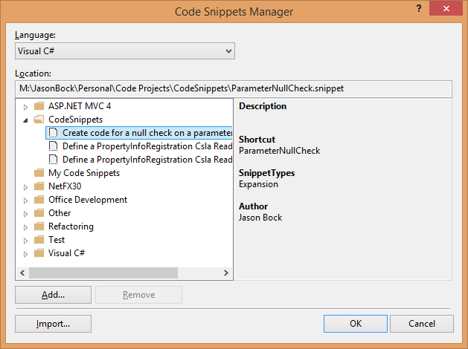
Snippets
Notes:
Once you create the snippet, you can import it via the Code Snippets Manager

Slide 15
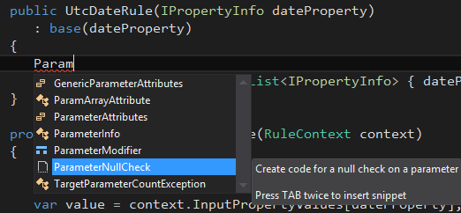
Snippets
Notes:
And then use it in your code

Slide 16
Demo: AssignmentWithNullCheck Code Snippet
Metaprogramming in .NET
Notes:
How do I make a code snippet for ArgumentNullException?

Slide 17

Reflection
http://scarlettlibrarian.files.wordpress.com/2010/12/reflection.jpg
Notes:
Reflection provides you to find out information about your code, and execute it if you want.

Slide 18
Reflection
Find test classes
[TestFixture]
public class MyTests
{
[Test]
public void MyTest() { }
[Test]
public void AnotherTest() { }
}
MyTests
Find test methods
MyTest
AnotherTest
Notes:
A testing framework uses reflection to find all of the test classes and test methods.

Slide 19
Reflection
public class AClass {}
public class AnotherClass {}
public class MyClass
{
public void MyMethod(string arg1,
Guid arg2) { ... }
}
Notes:
Here’s a simple piece of code, let’s look at how it would be represented in a Reflection graph

Slide 20
Reflection
Assembly
Type
Type
Type
MethodBase
ParameterInfo
ParameterInfo
Notes:
You have an assembly, types, methods, parameters, as well as events, properties, etc.

Slide 21
Reflection
MyAssembly
AClass
MyClass
AnotherClass
MyMethod
arg1
arg2
Notes:
Here’s what that code sample looks like with its names.

Slide 22
Reflection
var arg2Type = typeof(MyClass)
.GetMethod(nameof(MyClass.MyMethod))
.GetParameters()[1].ParameterType;
Notes:
If you’d want to get the type of the 2nd argument, here’s the code.

Slide 23
Reflection
var mine = new MyClass();
var invoke = typeof(MyClass)
.GetMethod(nameof(MyClass.MyMethod))
.Invoke(mine, new object[]
{ "data", Guid.NewGuid() });
Notes:
If you wanted to invoke a method on an object, here’s the code

Slide 24

Reflection
http://www.theawall.com/images/blog/time.jpg
Notes:
While Reflection is a powerful tool for metaprogramming, it can be slow. Always consider performance when using Reflection.

Slide 25
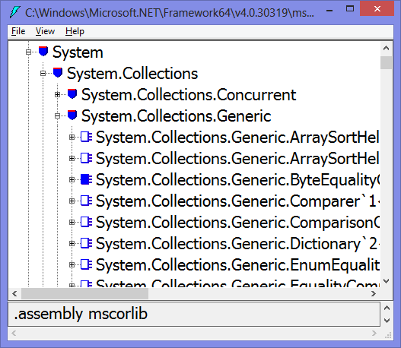
Expressions
Notes:
There’s a tool called ILDasm that’s been in the .NET installation since 1.0. It lets you see the guts of an assembly at its metadata level…

Slide 26
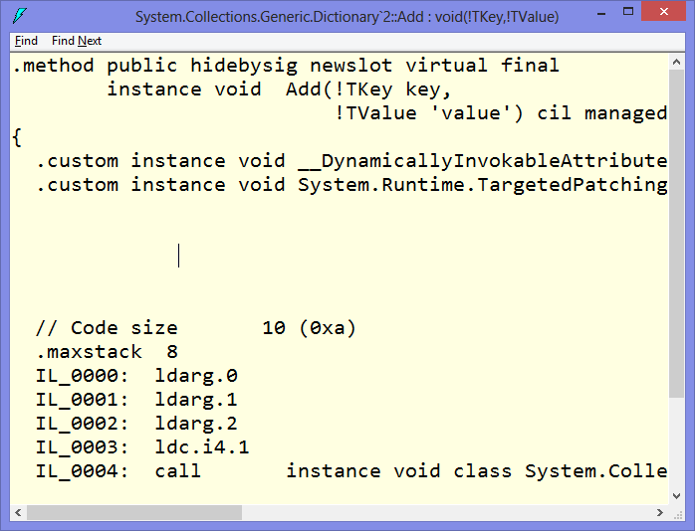
Expressions
Notes:
….and at the IL level.

Slide 27
Expressions
public sealed class NotNullAttribute :
InjectorAttribute<ParameterDefinition>{}
Notes:
With IL knowledge, you can do all sorts of tricks that C# or VB don’t support. For example, you can create generic attributes that can be consumed by C# and VB.

Slide 28
Expressions
System.Reflection.Emit
DynamicMethod
Notes:
Knowing IL is required if you want to run new code at runtime. If you wanted to create a new type, SRE was the way to do it. If you just needed a new method, use DynamicMethod (added in 2.0)

Slide 29
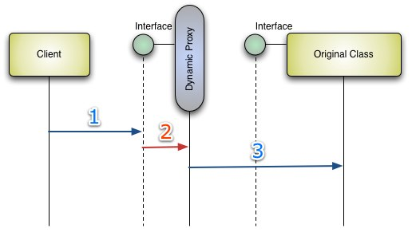
Expressions
http://www.theawall.com/images/blog/time.jpg
Notes:
With SRE, you can create dynamic proxies, which are used extensively by mocking engines.

Slide 30
Expressions
public string SayHello()
{
return "Hello";
}
Notes:
So what the issue with IL? It’s harder to understand, and it’s pretty easy to mess up. Take this simple function.

Slide 31
Expressions
.method public hidebysig instance string
SayHello() cil managed
{
.maxstack 8
ldstr "Hello"
ret
}
Notes:
Here’s the same function in IL.

Slide 32
Expressions
.method public hidebysig instance string
SayHello() cil managed
{
.maxstack 8
ret
}
Notes:
If the ldstr op code is gone, it’ll probably compile in ilasm, but running it will create all sorts of issues (e.g. InvalidProgramException)

Slide 33
Expressions
+
/
4
*
2
3
x
f(x) = ((3 * x) / 2) + 4
Notes:
Expressions allow you to view your code as a data structure – a tree. Basing an API on that can make it safer to generate code.

Slide 34
Expressions
var method = new DynamicMethod("m",
typeof(double), new Type[] { typeof(double) });
var parameter = method.DefineParameter(
1, ParameterAttributes.In, "x");
var generator = method.GetILGenerator();
generator.Emit(OpCodes.Ldc_R8, 3d);
generator.Emit(OpCodes.Ldarg_0);
generator.Emit(OpCodes.Mul);
generator.Emit(OpCodes.Ldc_R8, 2d);
generator.Emit(OpCodes.Div);
generator.Emit(OpCodes.Ldc_R8, 4d);
generator.Emit(OpCodes.Add);
generator.Emit(OpCodes.Ret);
var compiledMethod = method.CreateDelegate(
typeof(Func<double, double>)) as Func<double, double>;
Notes:
Here’s what that function looks like as a dynamic method

Slide 35
Expressions
var parameter =
Expression.Parameter(typeof(double));
var method = Expression.Lambda(
Expression.Add(
Expression.Divide(
Expression.Multiply(
Expression.Constant(3d), parameter),
Expression.Constant(2d)),
Expression.Constant(4d)),
parameter).Compile() as Func<double, double>;
Notes:
Here’s what it looks like using the LINQ expressions API.

Slide 36
Expressions
var propertyName = this.GetPropertyName(
_ => _.FirstName);
// Or, in C#6 and beyond (the "right" way)
// var propertyName =
// nameof(this.FirstName);
Notes:
We’ve all seen the property name trick, which uses LINQ expressions. It’s a little slower, but it’s “safe”. But there’s some really cool things you can do with expressions, like genetic programming.

Slide 37
Compilation
Notes:
Traditionally, compilers are black boxes. You don’t get access to what’s going on, and there’s lot of valuable information within.

Slide 38
Compilation
Syntax Tree API
Symbol API
Binding and Flow API
Emit API
https://github.com/dotnet/roslyn
Notes:
Roslyn opens up the compiler, providing APIs to different parts of the pipeline.

Slide 39
Compilation
ITest
Rock841914
: ITest
CallMe()
var rock = Rock.Create<ITest>();
rock.Handle(_ => _.CallMe(),
() => { return 42; });
var chunk = rock.Make();
chunk.CallMe();
Notes:
There’s lot of crazy things you can do if you can compile code on the fly. Let’s create a dynamic class that is a mock of another class (useful for testing)

Slide 40

Compilation
http://phillbarron.files.wordpress.com/2012/01/confused.jpg
Notes:
Makes total sense, right? ☺

Slide 41
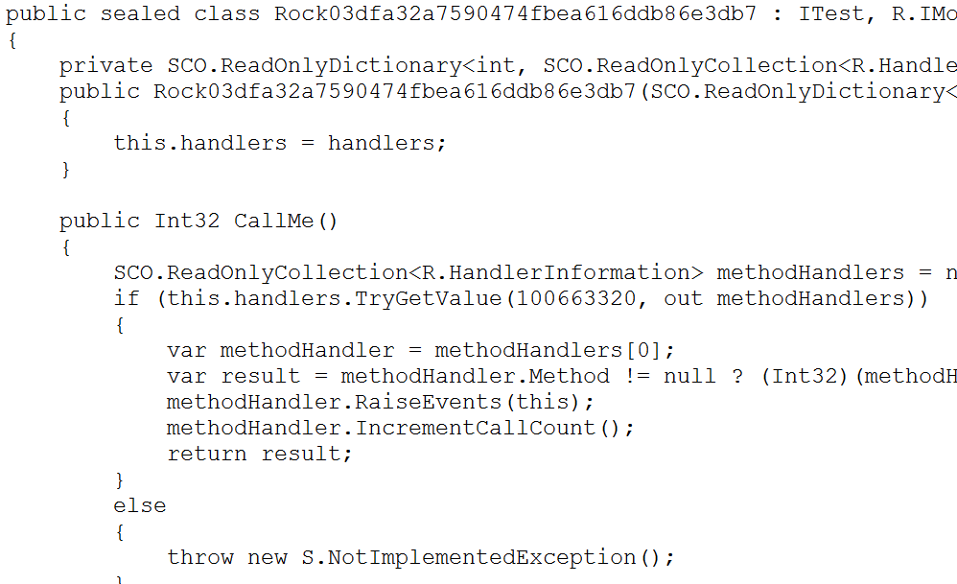
Compilation
Notes:
But I can take the generated proxy class, save it to disk, and step into the code

Slide 42

Compilation
https://github.com/JasonBock/rocks
Notes:
This is what my mocking library, Rocks, does

Slide 43
Demo: Rocks
Metaprogramming in .NET

Slide 44
Summary
What didn’t I cover?
CodeDom
T4
IL
System.Reflection.Emit
System.Reflection.Metadata (https://github.com/dotnet/corefx/tree/master/src/System.Reflection.Metadata)
Cecil (https://github.com/jbevain/cecil)
Sigil (https://github.com/kevin-montrose/Sigil)
Notes:
There are a bunch of other things you can use to do metaprogramming in .NET.

Slide 45
Summary
What didn’t I cover?
Dynamic
ExpandoObject
Clay (https://github.com/jhorv/Clay/)
Gemini (https://www.nuget.org/packages/gemini/ and https://github.com/nsabiyera/Oak)
Weavers
Injectors (https://github.com/jasonbock/injectors)
Fody (https://github.com/Fody/Fody)
PostSharp (https://www.postsharp.net/)
Notes:
There are a bunch of other things you can use to do metaprogramming in .NET.

Slide 46
Summary
C#.future
Source Generators (https://github.com/dotnet/roslyn/blob/master/docs/features/generators.md and https://github.com/dotnet/csharplang/issues/107)
Shapes and Extensions (https://github.com/dotnet/csharplang/issues/1711 and https://github.com/dotnet/csharplang/issues/164)
Notes:
It’s also my hope that C# will at some point in the future finally get more metaprogramming features within the language itself, though this request has been around for a quite a while and it’s never come to fruition.

Slide 47

Summary
http://upload.wikimedia.org/wikipedia/commons/d/de/CERO_fear.png
Notes:
Don’t fear metaprogramming. The tools may be a little more advanced than unusual, and you may need to invest some time, but it’s worth it.

Slide 48

Summary
http://upload.wikimedia.org/wikipedia/commons/d/de/CERO_fear.png
Notes:
Embrace metaprogramming. It’ll make your coding peaceful ☺

Slide 49
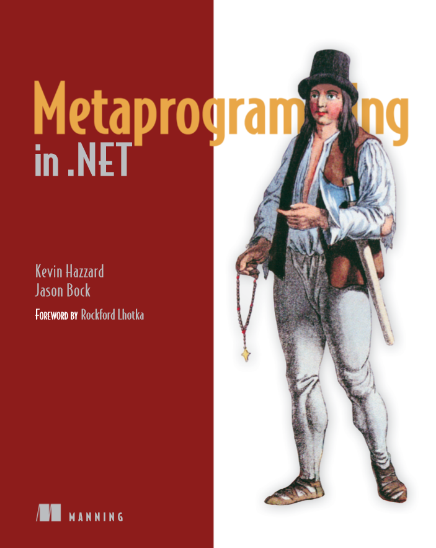
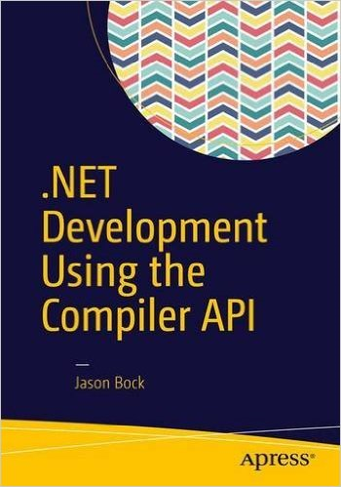
Shameless Plug
http://manning.com/hazzard/
https://www.apress.com/us/book/9781484221105
Notes:
Some books I’ve written… ☺

Slide 50
Metaprogramming in .NET
Jason Bock
Practice Lead
Remember…
https://github.com/JasonBock/CodeSnippets
https://github.com/JasonBock/Rocks
https://github.com/JasonBock/Presentations/blob/master/Metaprogramming%20in%20.NET.pptx
References in the notes on this slide
Notes:
GitHub repos
Csla.AutoAddBusinessRules
CodeSnippets
ExpressionEvolver
Injectors
Rocks
References
Awesome Roslyn - https://github.com/ironcev/awesome-roslyn/blob/master/readme.md
Welcome to roslyn-analyzers documentation - https://roslyn-analyzers.readthedocs.io/en/latest/
Code Snippets (C#) - https://msdn.microsoft.com/en-us/library/f7d3wz0k(v=vs.90).aspx
Creating and Using IntelliSense Code Snippets - https://msdn.microsoft.com/en-us/library/vstudio/ms165392(v=vs.100).aspx
Comparison of code generation tools - http://en.wikipedia.org/wiki/Comparison_of_code_generation_tools
Sigil: Adding Some (More) Magic To IL - http://kevinmontrose.com/2013/02/14/sigil-adding-some-more-magic-to-il/
Visual Studio Code Snippets - http://visualstudiocodesnippets.com/
Visual Studio code snippets - http://www.codeproject.com/Articles/737354/Visual-Studio-code-snippets

